Slide 1
Flood Early Warning System for San Jacinto County Matt Barrett & Briana Gallagher Flood Management Division Send emails to: floodmanagementdivision@sjra.net

Slide 2
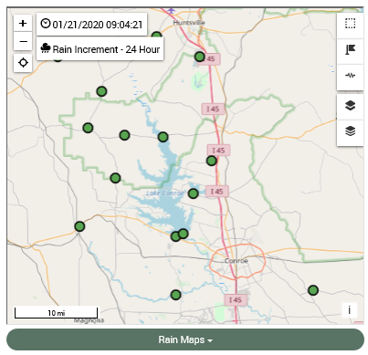
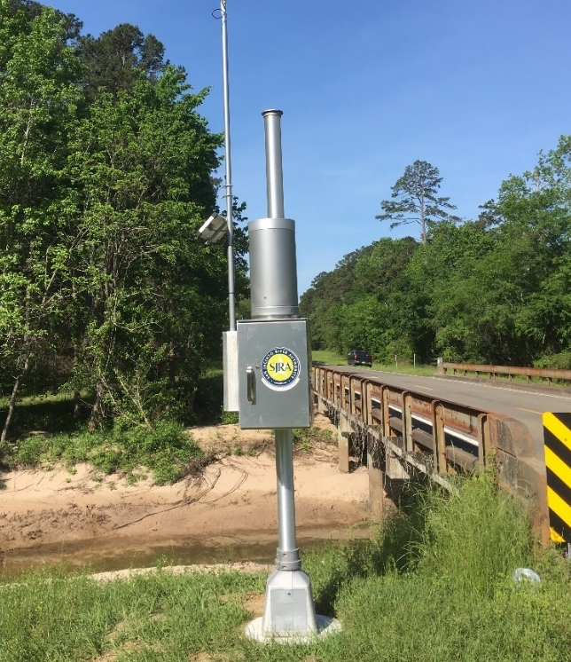
Flood Early Warning System
Existing System - Background / Purpose
Established in the early 1980s as a real-time system to facilitate operational awareness for SJRA staff at Lake Conroe Dam
System monitors network of hydrometeorological gauges known as ALERT (Automated Local Evaluation in Real Time)
Collects weather, rainfall, stream conditions/levels, and lake level data for real-time monitoring of the Lake Conroe watershed and a few other locations
Notes:
Work is over 90% complete
Automated Local Evaluation in Real Time (ALERT)
Mention the weather monitoring station demo unit

Slide 3
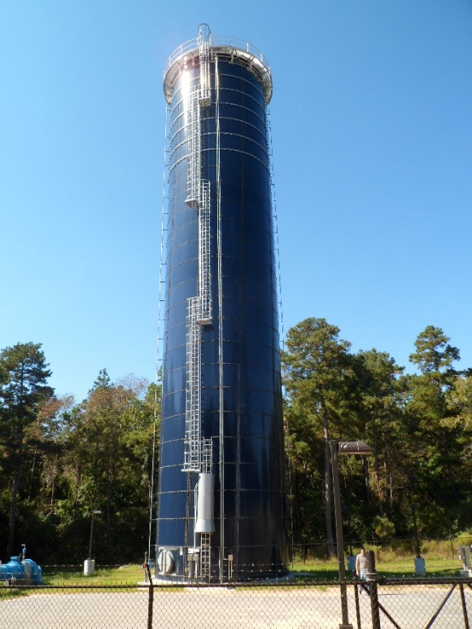
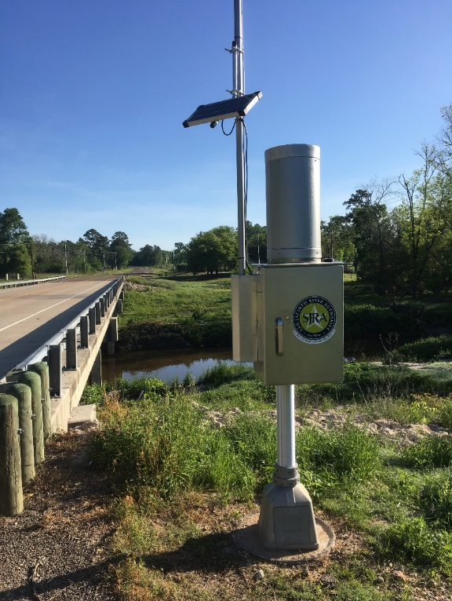
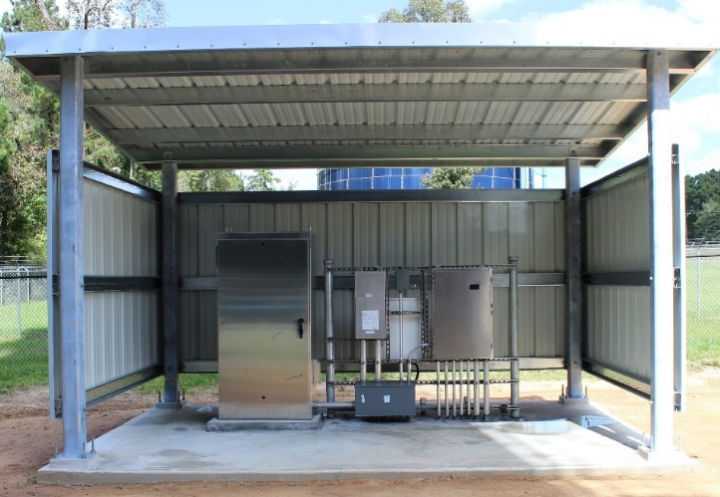
Flood Early Warning System
2018 Enhancements
Network architecture upgraded from ALERT to ALERT2
System expanded with addition of new rain and stream gages
New Antenna & Repeater - includes elevated height antenna, repeater cabinets, controls and power supply

Slide 4
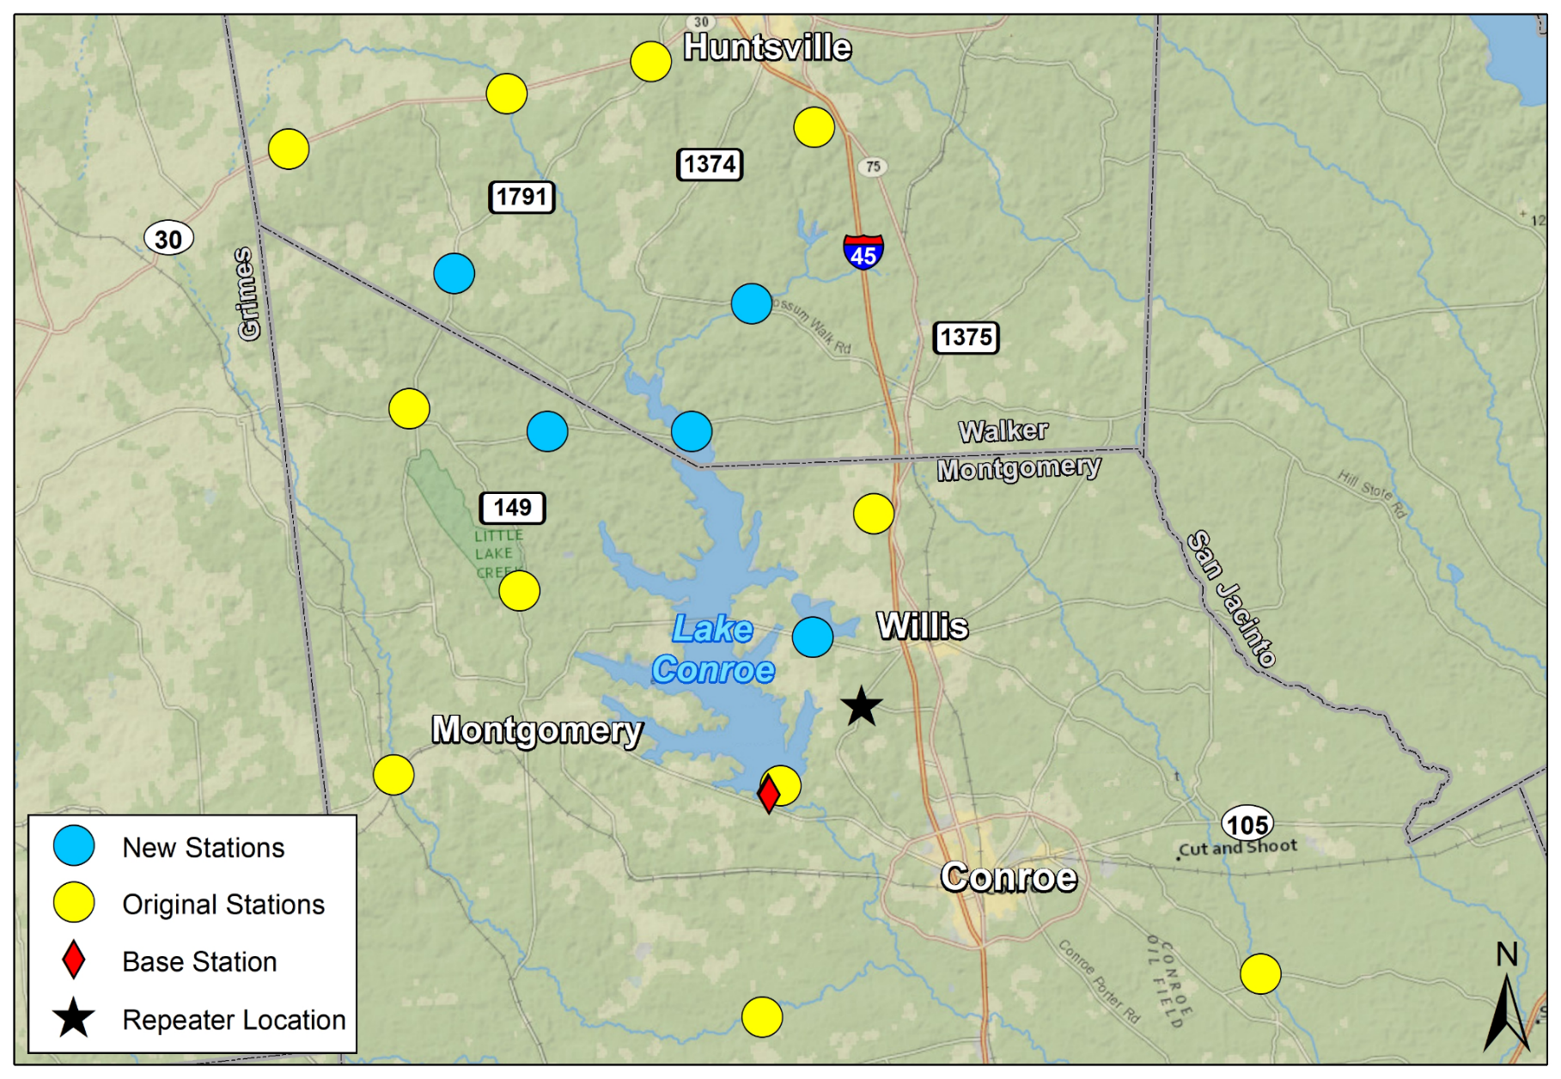
Flood Early Warning System
Flood Early Warning System
Existing Gage Network
Notes:
W/ depiction (transitions) of current stations, moved and/or upgraded stations, new installs, Standpipe locations, and SJRA Base Station
Addition of stream depth monitoring allows flow estimates in real time.

Slide 5
Existing Network Architecture
Flood Early Warning System
ALERT2
ALERT
ALERT2 RF_{F1}
ALERT2 RF_{F1}
ALERT2 RF_{F1}
SJRA IP Network
ALERT repeater upgraded to ALERT/ALERT2 Concentrator
ALERT2
Receiver and base station software upgraded to ALERT2-capable
Upgraded from ALERT to ALERT2
Notes:
Upgrade existing gages to ALERT 2
Upgrade Tower and move to new location for better reception
Provide gage i

Slide 6
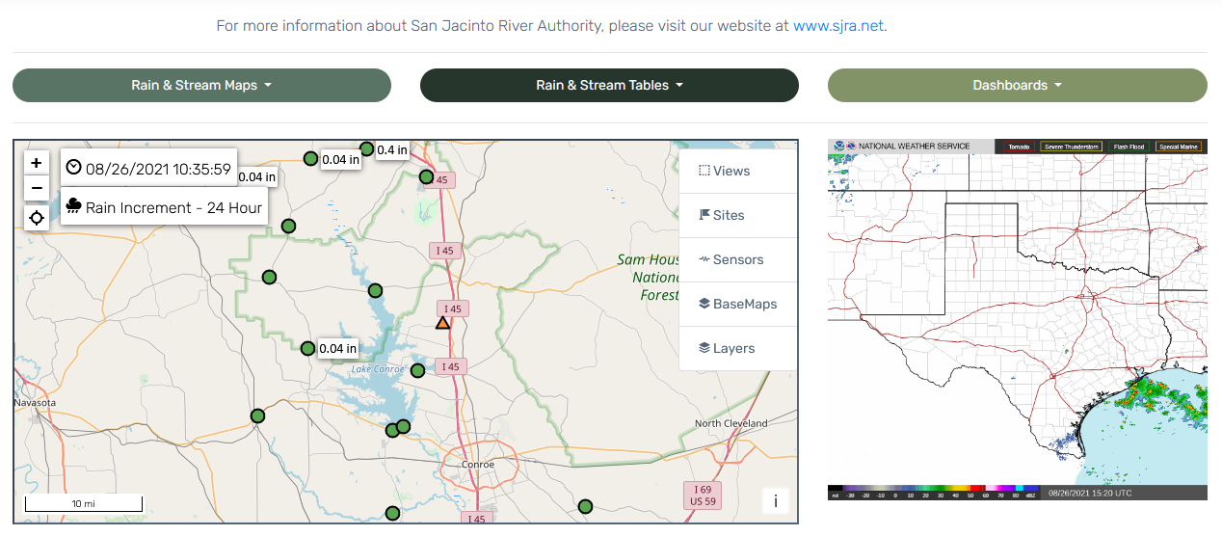
Flood Early Warning System
Contrail® System Web Viewer

Slide 7
Flood Early Warning System
Part of a Larger System
Existing gage network provides useful information to larger regional Harris County Flood Warning System
Larger system comprised of 175+ gage stations managed by various agencies, including Harris County Flood Control District (HCFCD), TxDOT, Trinity River Authority, The Woodlands, City of Houston, Brazoria County, and Fort Bend County
Data is shared with the HCFCD’s Regional Partners Group, staff hydrologists at the National Weather Service (NWS) office in League City, NWS West Gulf Coast River Forecast Center in Fort Worth, and local Emergency Management Offices

Slide 8
Current Project

Slide 9
Flood Early Warning System
2019:
Senate Bill 7 (Creighton, Phelan) passed creating the Flood Infrastructure Fund (FIF) and Texas Infrastructure Resiliency Fund (TIRF) for making loans and grants for flood mitigation projects.
JAN 2020:
SJRA and San Jacinto County identify flood early warning system (FEWS) partnership opportunity to submit application for funding through the FIF.
OCT 2020:
SJRA submits final application for FEWS project to Texas Water Development Board (TWDB).
DEC 2020:
SJRA receives funding approval from Texas Water Development Board.
MAR-AUG 2021:
SJRA and San Jacinto County execute an Interlocal Agreement and the FEWS project begins.

Slide 10
Flood Early Warning System
Project will be funded by $48,100 in grants and $16,900 in-kind services/local match provided by SJRA.
San Jacinto County will provide funding for annual O&M (up to $15,000 per year) of gages by SJRA staff.
Project requires coordination with multiple agencies.

Slide 11
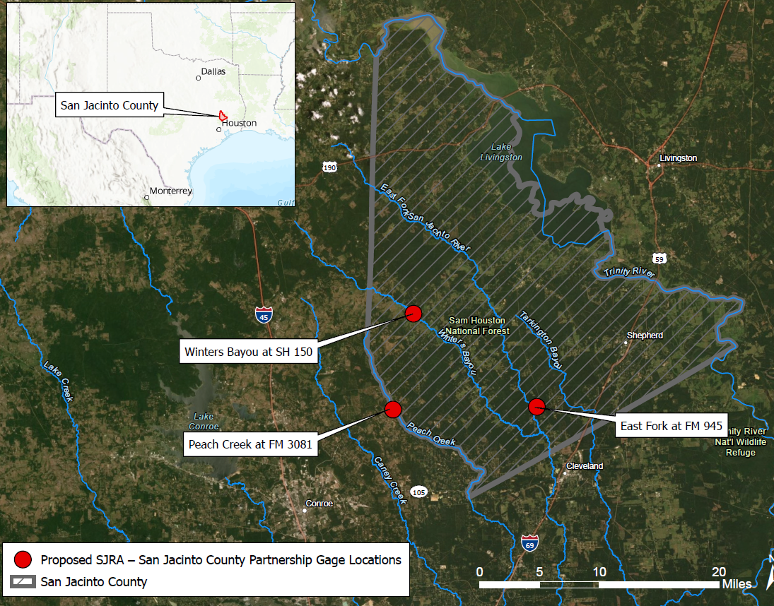
Flood Early Warning System
The purpose of this project is to install rain and river/stream gaging equipment at three (3) locations identified as critical by San Jacinto County.
The locations have been selected by San Jacinto County and are:
Winters Bayou at State Highway 150
East Fork San Jacinto River at FM 945
Peach Creek at FM 3081

Slide 12
Flood Early Warning System
The downstream areas have been impacted by several previous storm events causing road closures, high water rescues, etc. These previous storms include:
Hurricane Harvey (2017)
Hurricane Ike (2008)
Hurricane Rita (2005)
Storms in 1994, 1998, 2015, and 2016
These have historically been low population areas, but are growing rapidly

Slide 13
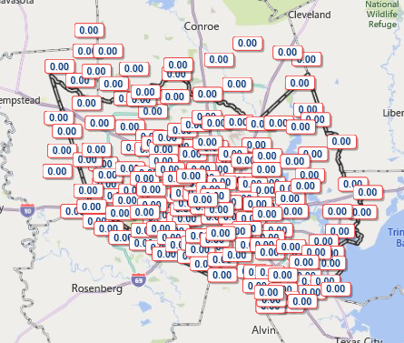
Flood Early Warning System
The intent of the project is to provide early warning to residents, businesses, property owners, OEM, etc. downstream of the gage locations.
The FEWS will assist in the protection of life and property.
Once constructed, data obtained from the gage sites will be transmitted to SJRA’s ALERT2 network and displayed on SJRA’s Contrail website.
Information shared with Harris County FWS, sign up for alerts.

Slide 14
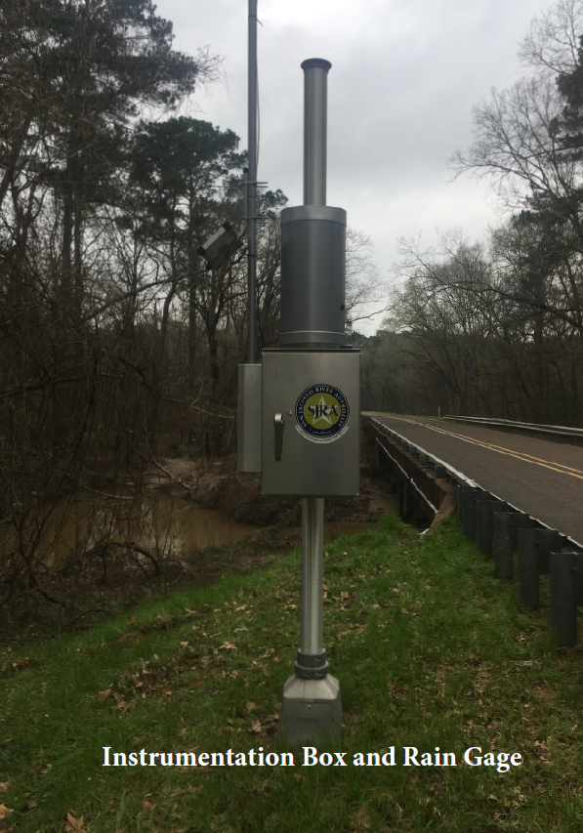
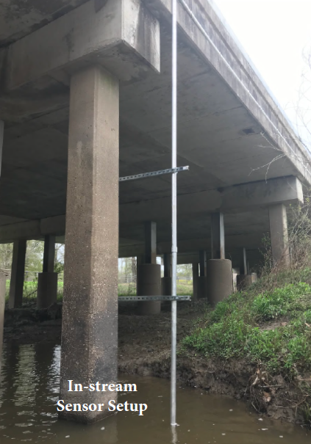
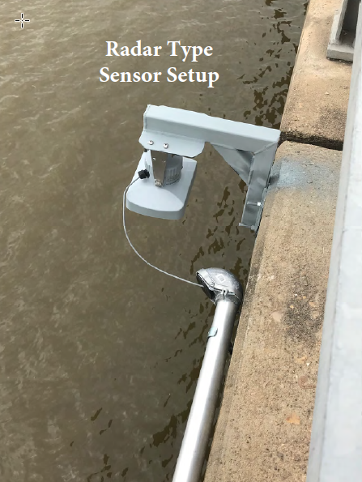
Flood Early Warning System

Slide 15
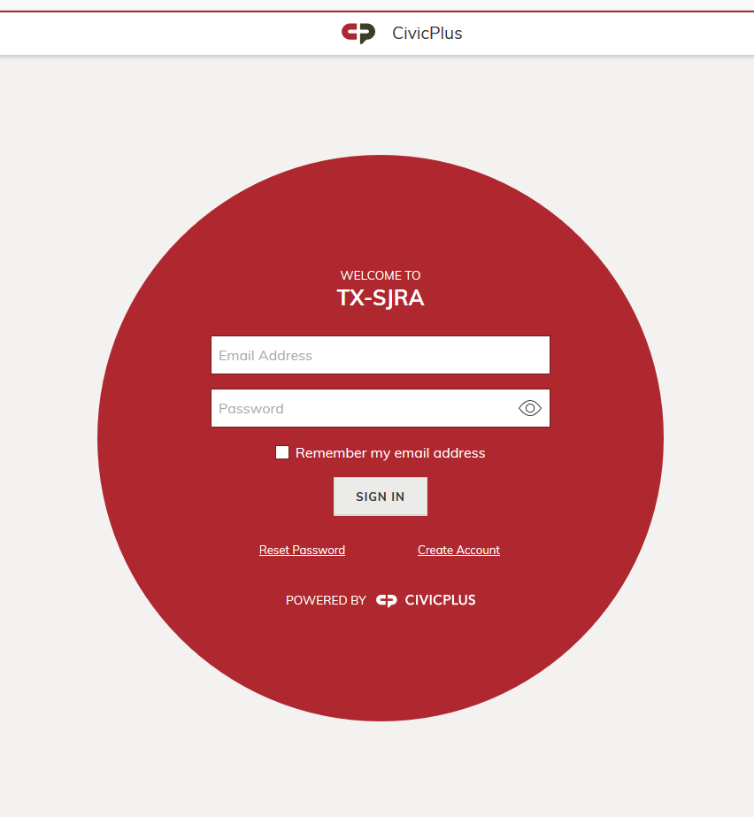
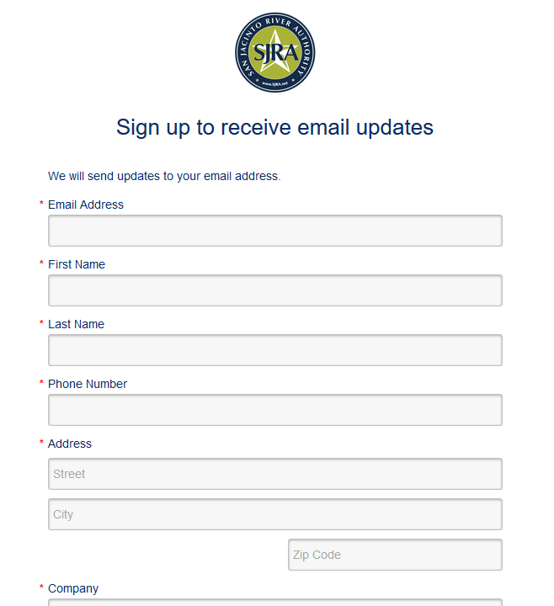
Additional Information
www.sjra.net
CivicReady-Text
Constant Contact-Email
Facebook
Twitter
HarrisCountyFWS.org

Slide 16
Flood Early Warning System
Questions?
(Please sign in before you leave)

