Slide 1

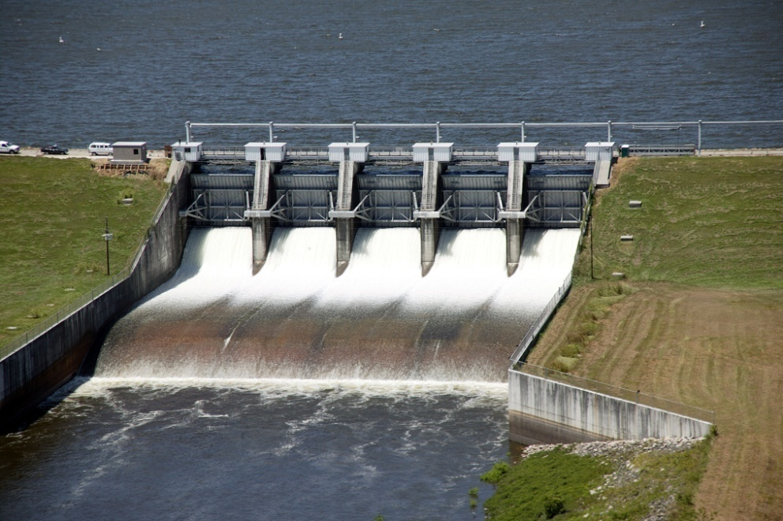
Montgomery County Alternative Water Supply
November 13, 2008

Slide 2


LSGCD DRP Phase IIA
REQUIREMENTS

Slide 3
LSGCD Requirements
64,000 afpy Aquifer Yield
30% Groundwater Reduction
by January 1, 2015
Applicable to all Permittees > 10 MGY (i.e., Single County-wide Zone)
LVGUs Submit WRAP
  Part I – Sept. 1, 2008
  Part II – March 2, 2009
Joint WRAP & Group Compliance Allowed in Regulations
Notes:
Excellent participation.

Slide 4


WRAP PART I UPDATE
Submitted early
Thanks to 198 participants
Questionnaires? Please respond

Slide 5
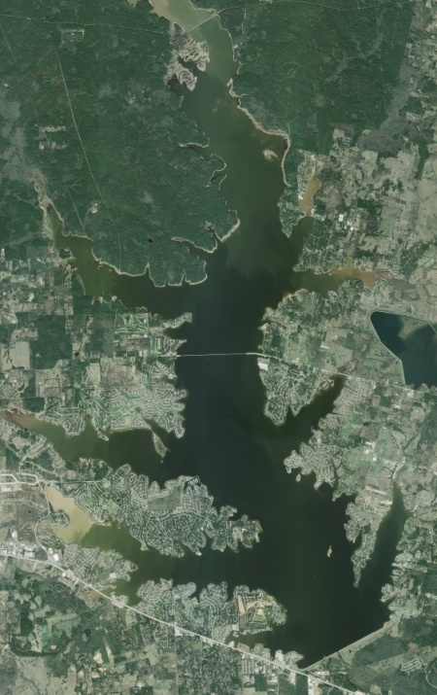
Joint WRAP Participants
201 Large Volume Groundwater Users
~ 3 entities doing their own WRAP
(City of Houston, Conroe Country Club,
Wedgewood Golf Club)
198 Participants in SJRA Joint WRAP
Timeline
  August 28, 2008 – WRAP Part I submitted
  March 2, 2009 – WRAP Part II due
Notes:
Excellent participation.

Slide 6
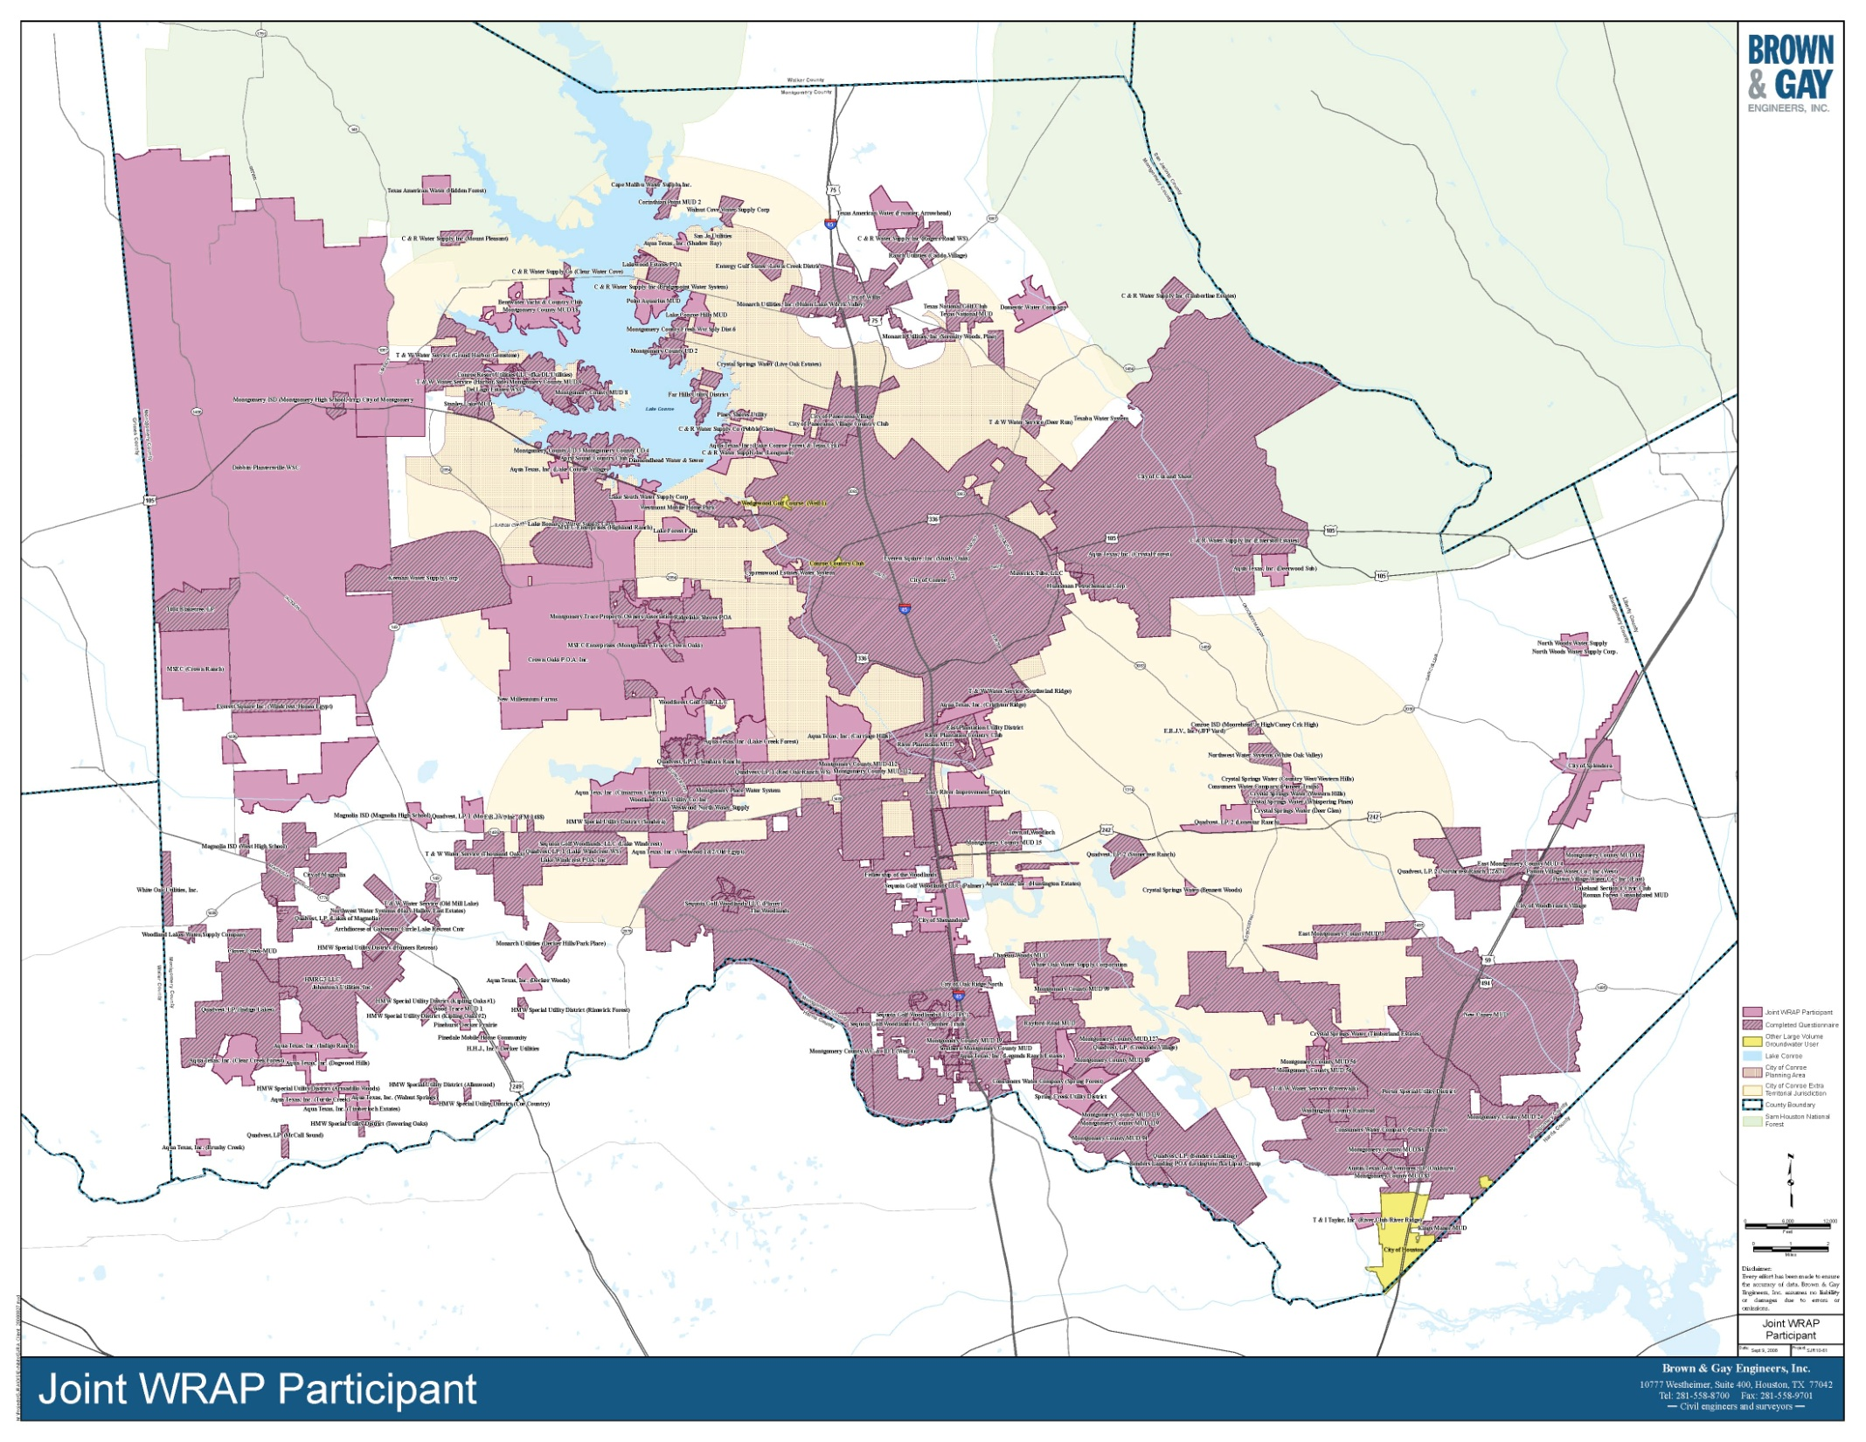
Joint WRAP Participants

Slide 7
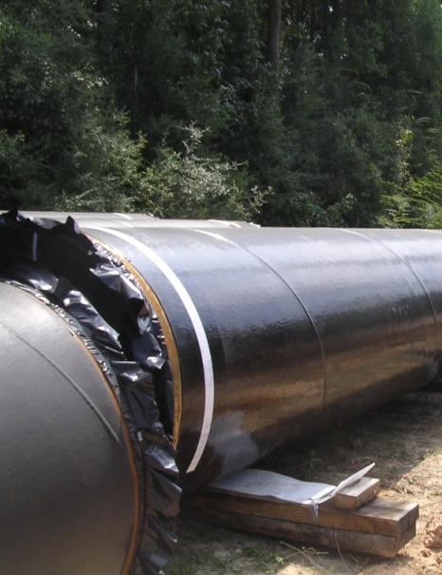


LSGCD WRAP II Elements
Water Supply Sources / Strategies
Infrastructure Requirements
Construction Timeline
Costs and Financing Methods
Preliminary Engineering for 2015
Conceptual for Future Phases

Slide 8
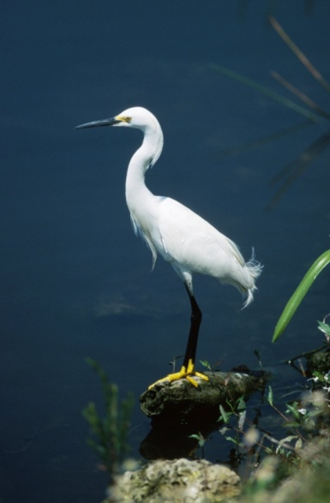
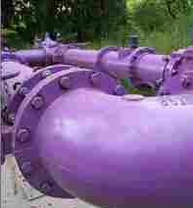
Joint WRAP
Initial Strategies
  Surface Water Conversion
  Water Conservation
  Drought Management
  Reuse

Slide 9
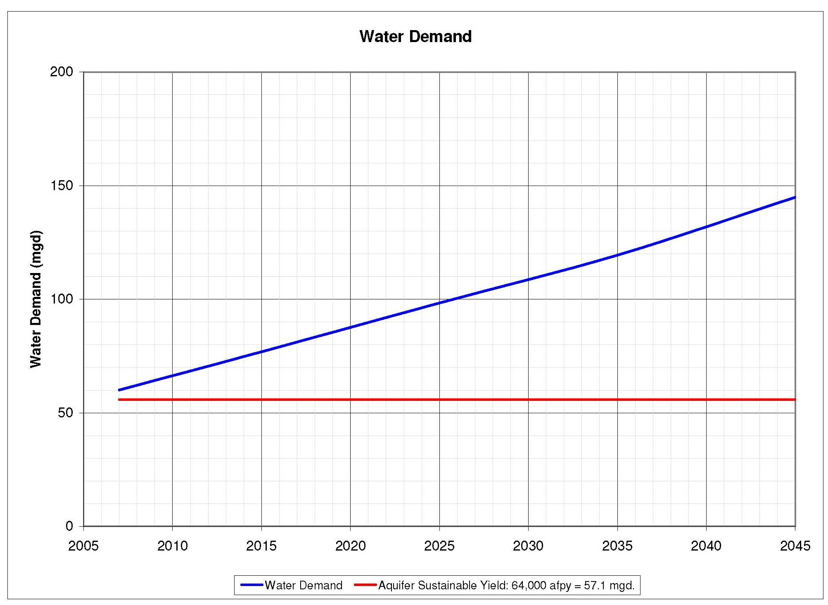

Slide 10
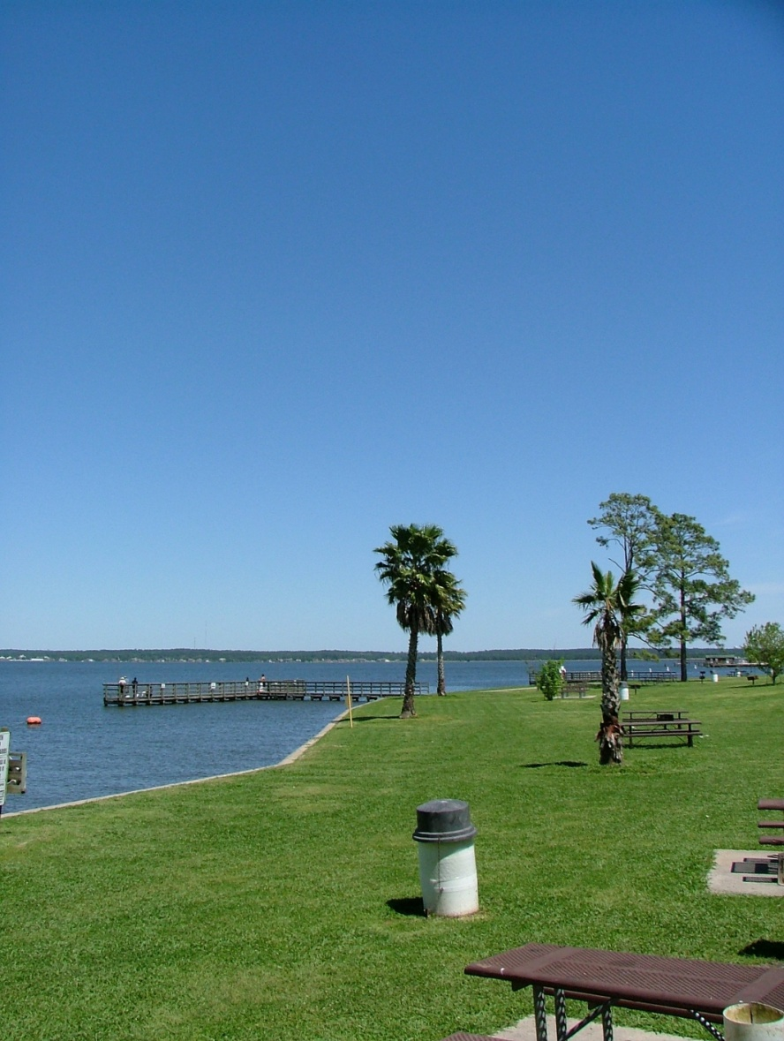
Source Alternatives
Analysis

Slide 11
Alternative Source Summary
WR Trade – SJRA Trinity River for COH Lake Conroe
WR Trade – SJRA San Jacinto Basin for COH Lake Conroe
Purchase of COH Lake Conroe Rights
Luce Bayou Participation
Long-Term Contract With NHCRWA
Long-Term Contract for COH Lake Conroe Water
Long-Term Contract for TRA Water at Huntsville
Long-Term Contract for COH and TRA Water
Long-Term Contract for Imported Groundwater

Slide 12
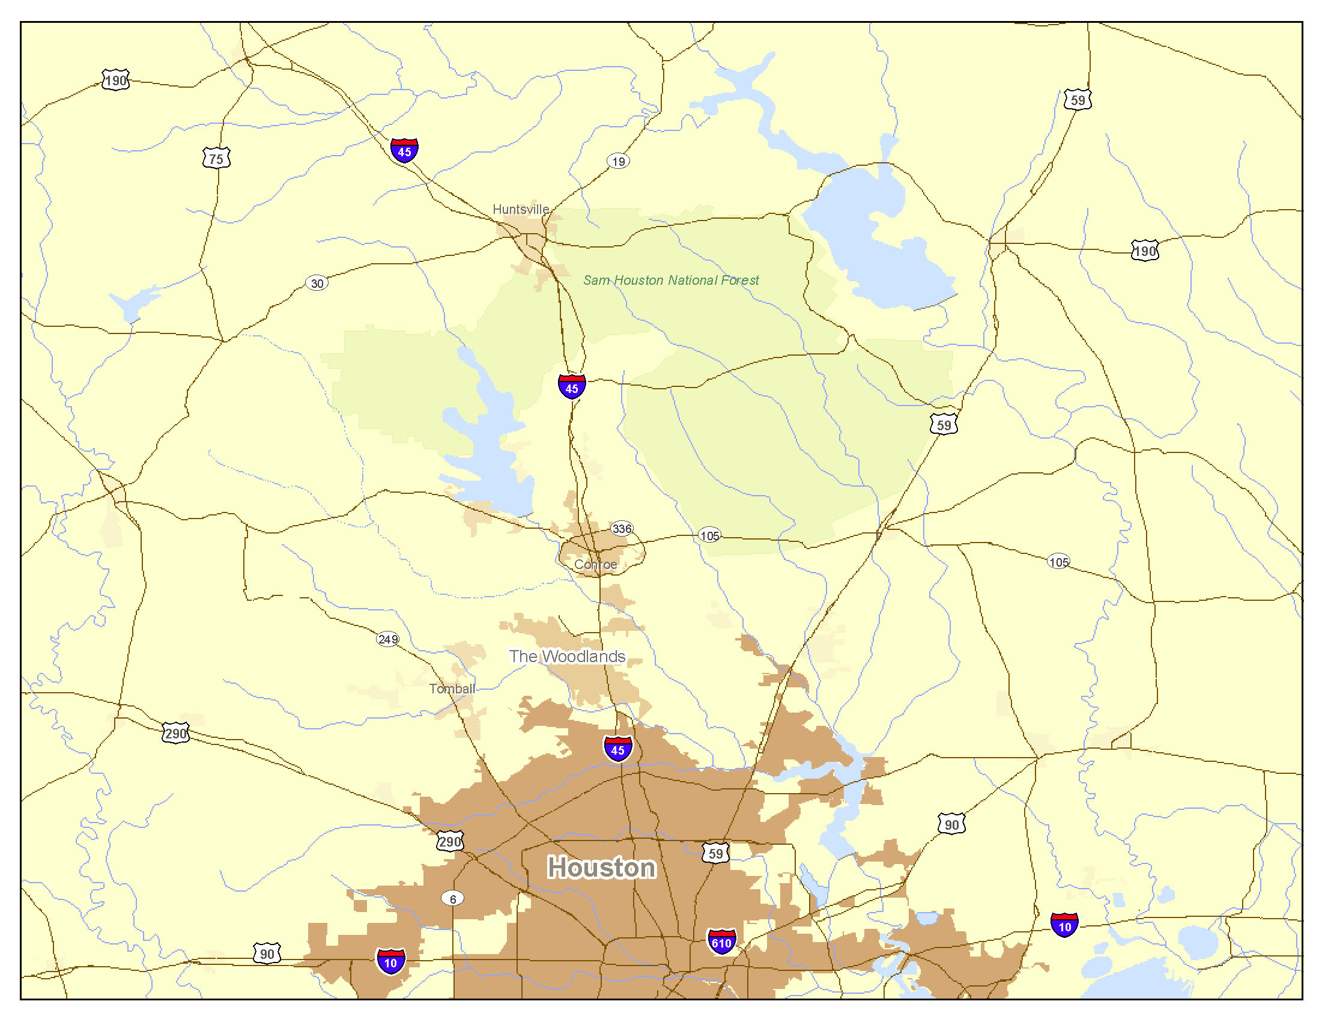
Trinity River
Surface Water Supply Demands
Lake
Livingston
Lake
Conroe
Montgomery County
25,000 afpy– 2015
50,000 afpy – 2025
75,000 afpy– 2035
100,000 afpy- 2045
West Fork
San Jacinto River
Trinity River
Luce Bayou
Lake
Houston
Highlands
80,000 afpy
Highlands
Reservoir

Slide 13
Water Rights Trade
SJRA Trinity River Rights for
COH Lake Conroe Rights
Trinity River
Lake
Livingston
Lake
Conroe
COH Lake
Conroe Rights
SJRA
West Fork
San Jacinto River
Trinity River
Luce Bayou
Lake
Houston
COH
SJRA Trinity
Rights
Highlands
Reservoir

Slide 14
Trinity River
Water Rights Trade
SJRA San Jacinto Rights for
COH Lake Conroe Rights
Lake
Livingston
Lake
Conroe
COH Lake
Conroe Rights
SJRA
West Fork
San Jacinto River
Luce Bayou
Lake
Houston
Trinity River
SJRA San Jacinto Rights
COH
Highlands
Reservoir

Slide 15
Trinity River
Purchase of COH Lake Conroe Rights
Lake
Livingston
Lake
Conroe
COH Lake
Conroe Rights
SJRA
$
COH
West Fork
San Jacinto River
Luce Bayou
Trinity River
Lake
Houston
Highlands
Reservoir

Slide 16
SJRA Participation in Luce Bayou for
COH Lake Conroe Water
Trinity River
Lake
Livingston
Lake
Conroe
COH Lake
Conroe Water
SJRA
SJRA
$
COH
West Fork
San Jacinto River
Luce Bayou
Trinity River
Lake
Houston
Highlands
Reservoir

Slide 17
Long-term Water Supply Contract With NHCRWA
Trinity River
Lake
Livingston
Lake
Conroe
West Fork
San Jacinto River
SJRA
Luce Bayou
Trinity River
$
Lake
Houston
NHCRWA
COH
Highlands
Reservoir

Slide 18
Long-term Water Supply Contract For
COH Lake Conroe Water
Trinity River
Lake
Livingston
Lake
Conroe
COH Lake
Conroe Water
$
SJRA
COH
West Fork
San Jacinto River
Luce Bayou
Trinity River
Lake
Houston
Highlands
Reservoir

Slide 19
Long-term Water Supply Contract For TRA
Trinity River Water
Trinity River
TRA Water
Lake
Livingston
Lake
Conroe
SJRA
$
TRA
West Fork
San Jacinto River
Luce Bayou
Trinity River
Lake
Houston
Highlands
Reservoir

Slide 20
Trinity River
TRA Water
Lake
Livingston
Lake
Conroe
COH Lake
Conroe Water
$
TRA
COH
SJRA
Long-term Water Supply Contract For COH Lake Conroe Water and TRA Replacement Water
West Fork
San Jacinto River
Luce Bayou
Trinity River
Lake
Houston
Highlands
Reservoir

Slide 21
Trinity River
SJRA Trinity River Rights for
Montgomery County
Lake
Livingston
Lake
Conroe
Trinity River
SJRA Trinity
Rights
Luce Bayou
West Fork San Jacinto River
Lake
Houston
Highlands
Reservoir

Slide 22
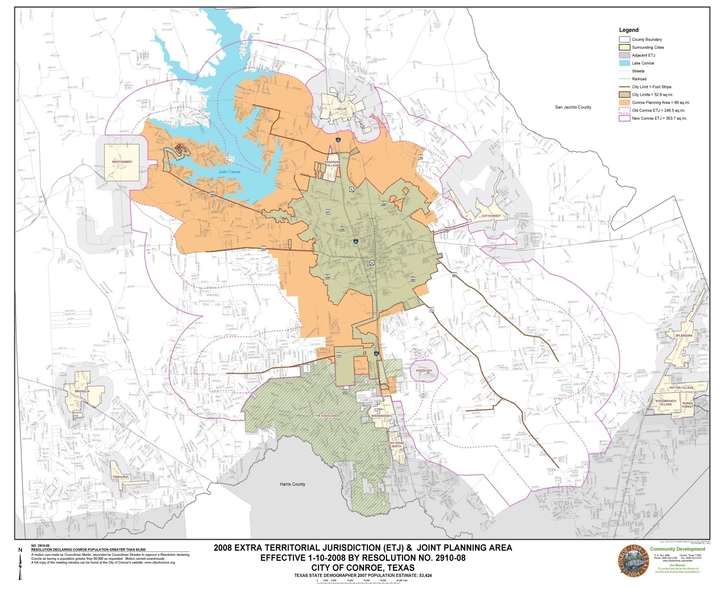

Slide 23
Coordination
DRP
WRAP

Slide 24
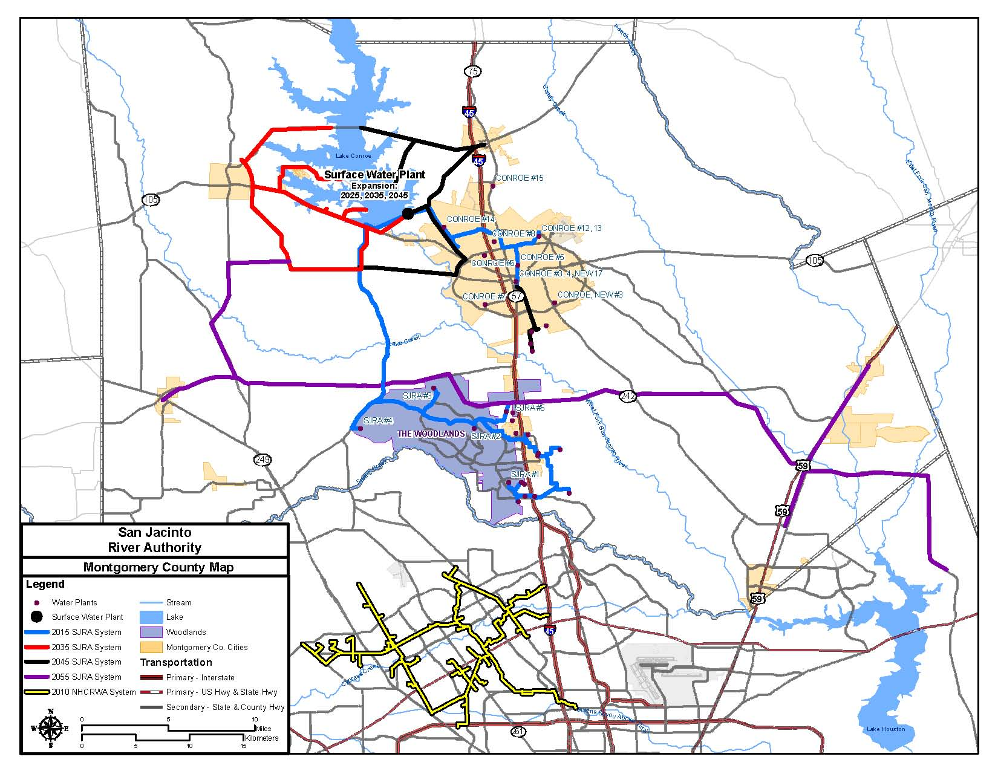
Preliminary Distribution Routes

Slide 25
* Includes 5% Inflation

Slide 26
* Includes 5% Inflation

Slide 28

Alignment Alternatives
Analysis

Slide 29
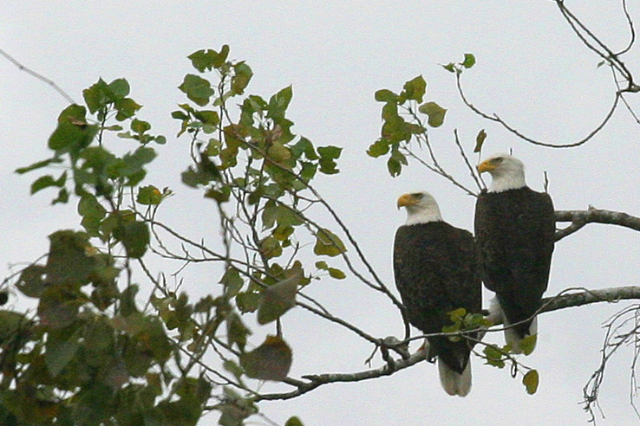
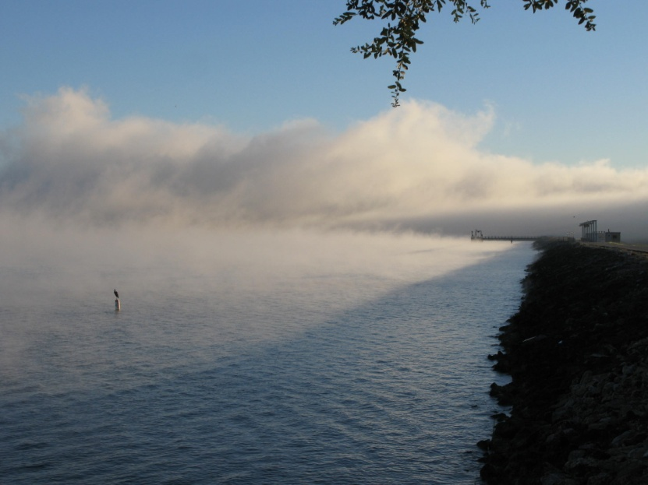
Environmental Considerations
Soils
Vegetation
Threatened and
Endangered Species
Migratory Birds
Floodplains
Wetlands
Cultural Resources
Hazardous Materials
Land Use

Slide 30
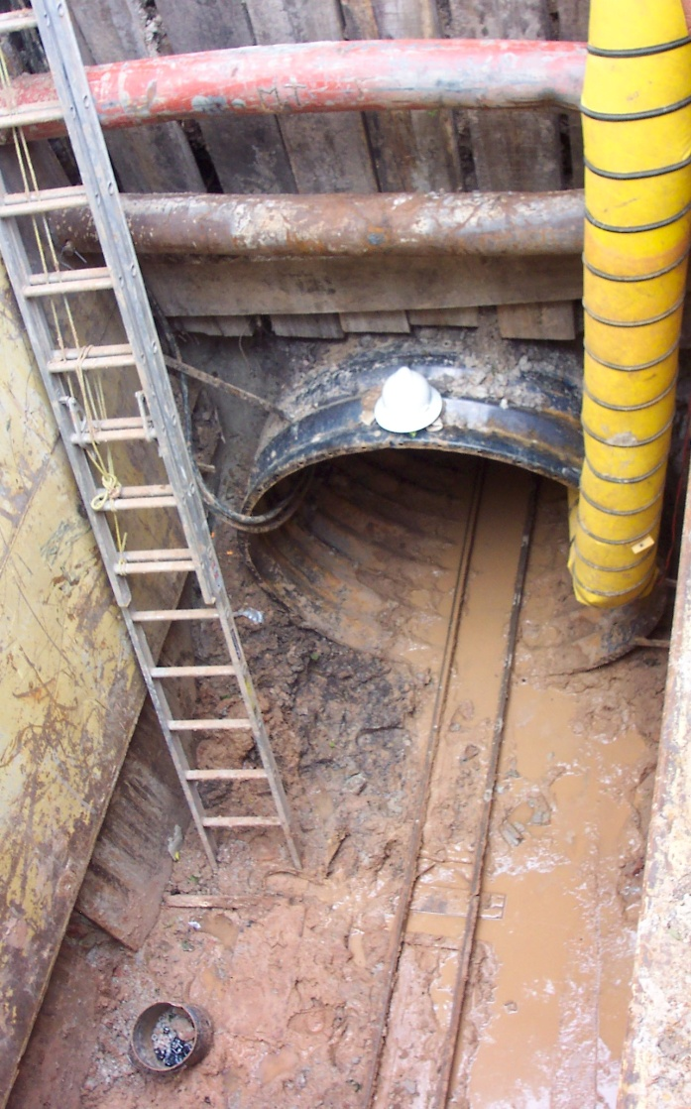
Engineering Considerations
Pipe Sizing
Crossing / Conflict Issues
  Roadways
  Railroads
  Public/Private Utilities
  Pipelines
Meeting 2015 through
2045 demands
Program Costs
  Land Acquisition
  Engineering/Legal
  Construction
  Operation and Maintenance

Slide 31
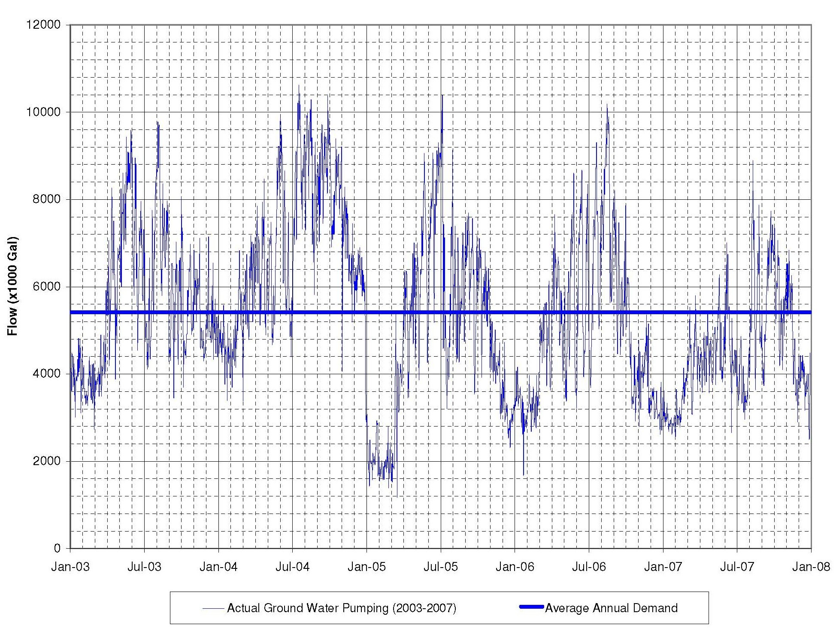
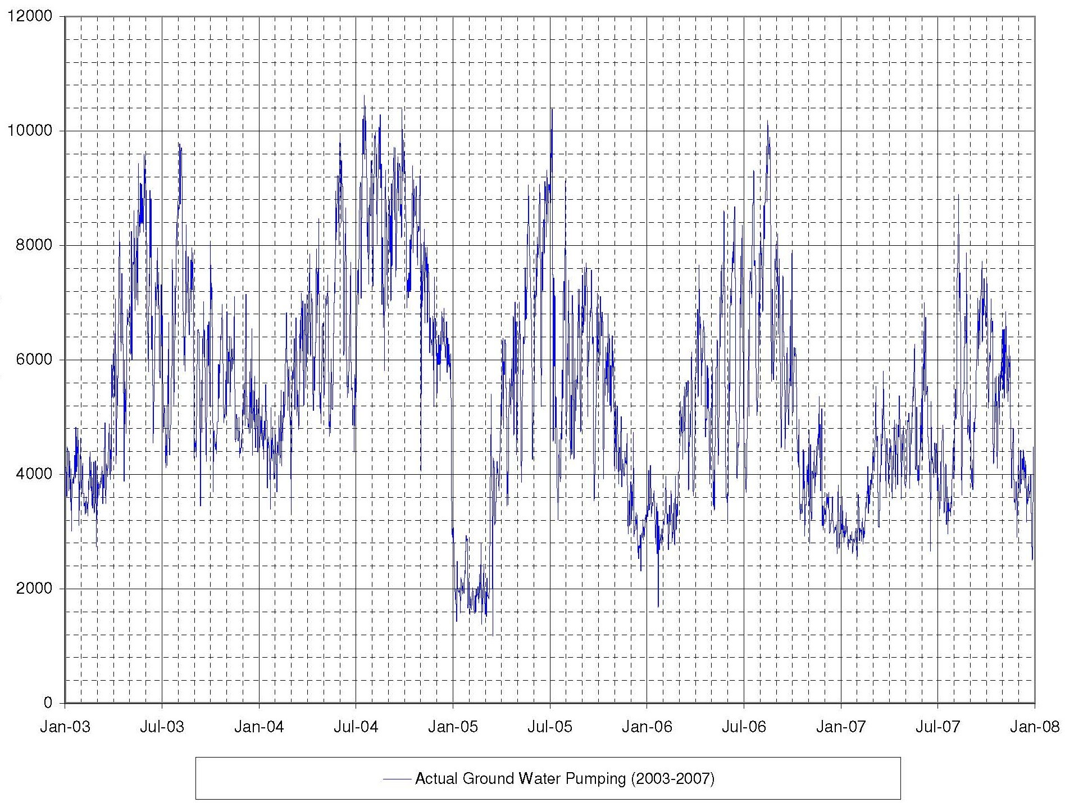
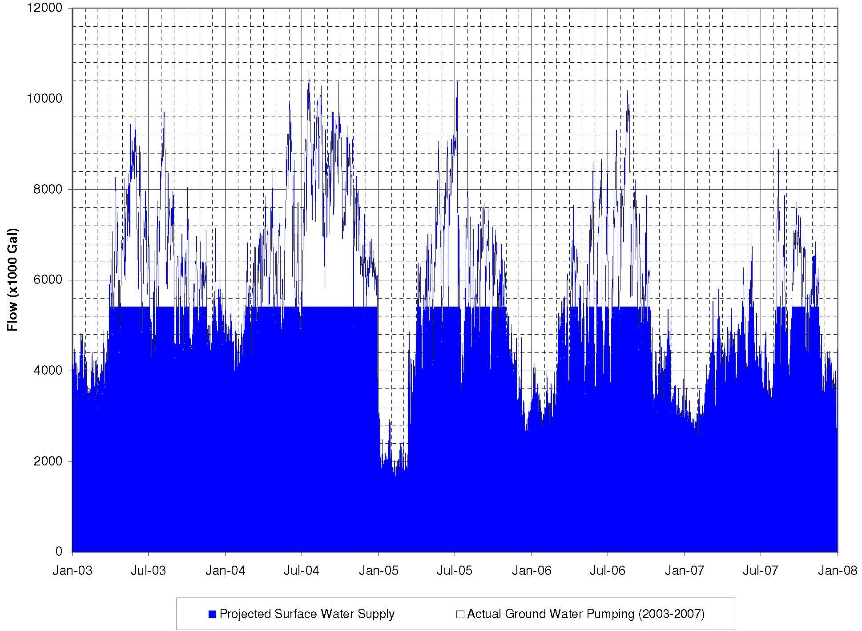
Average Annual Water Demand
Notes:
Click to advance – three charts

Slide 32
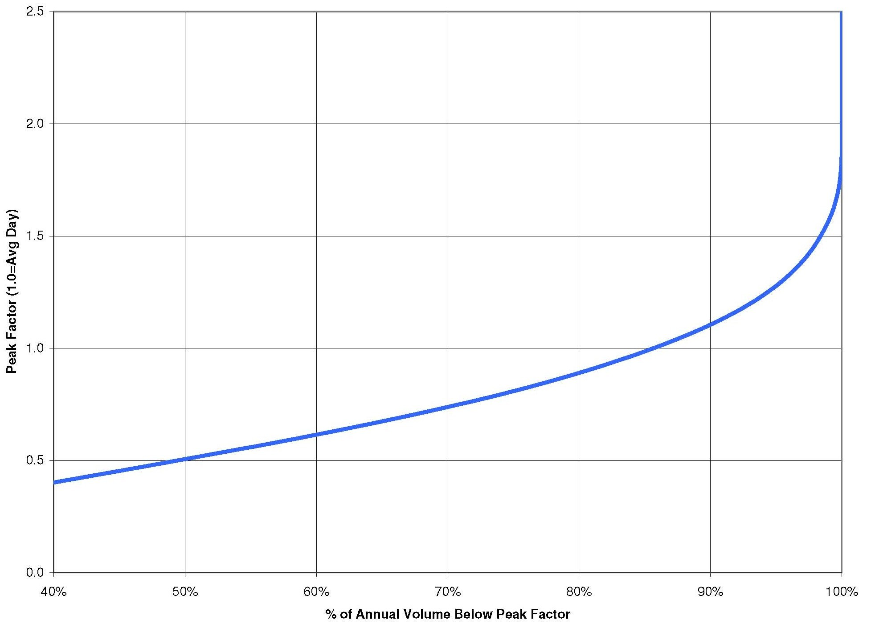
Compliance Assurance Factor Development
*Well 37 and 38 added from 2007 data 11/7/2008

Slide 33
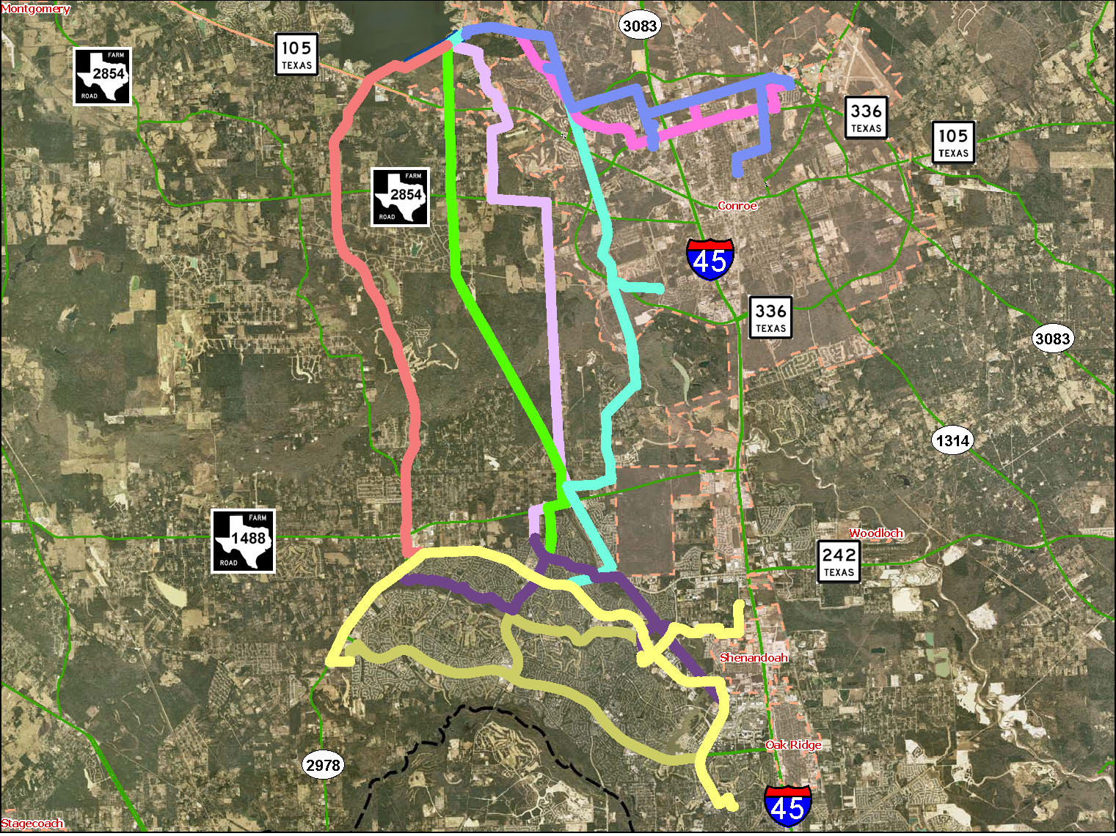
Transmission Line Alternatives

Slide 34
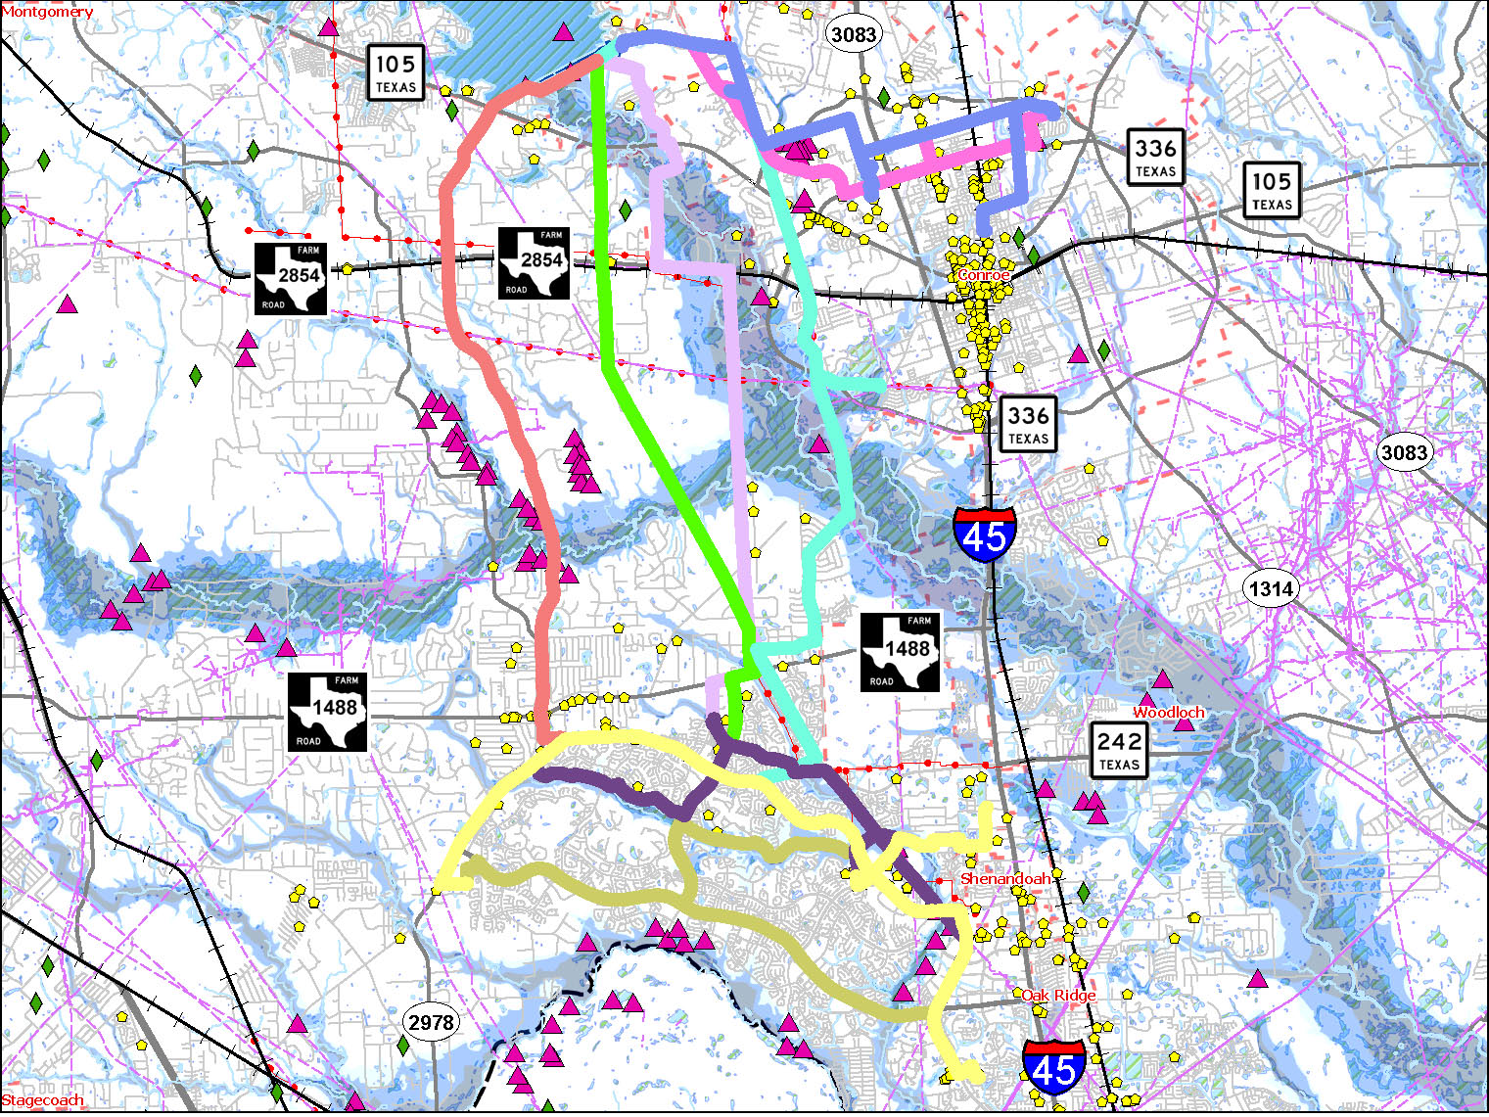
Transmission Line Alternatives

Slide 35
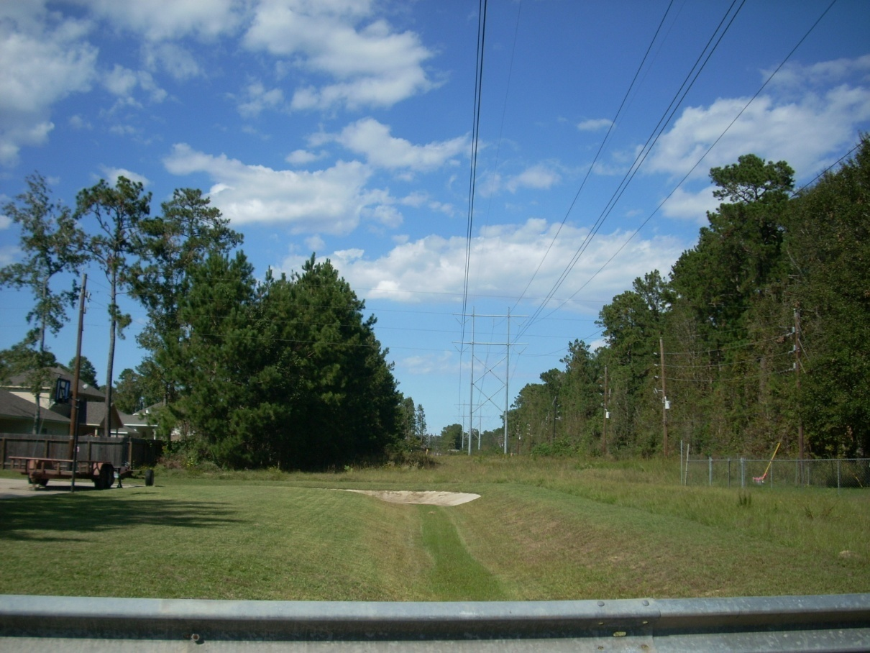
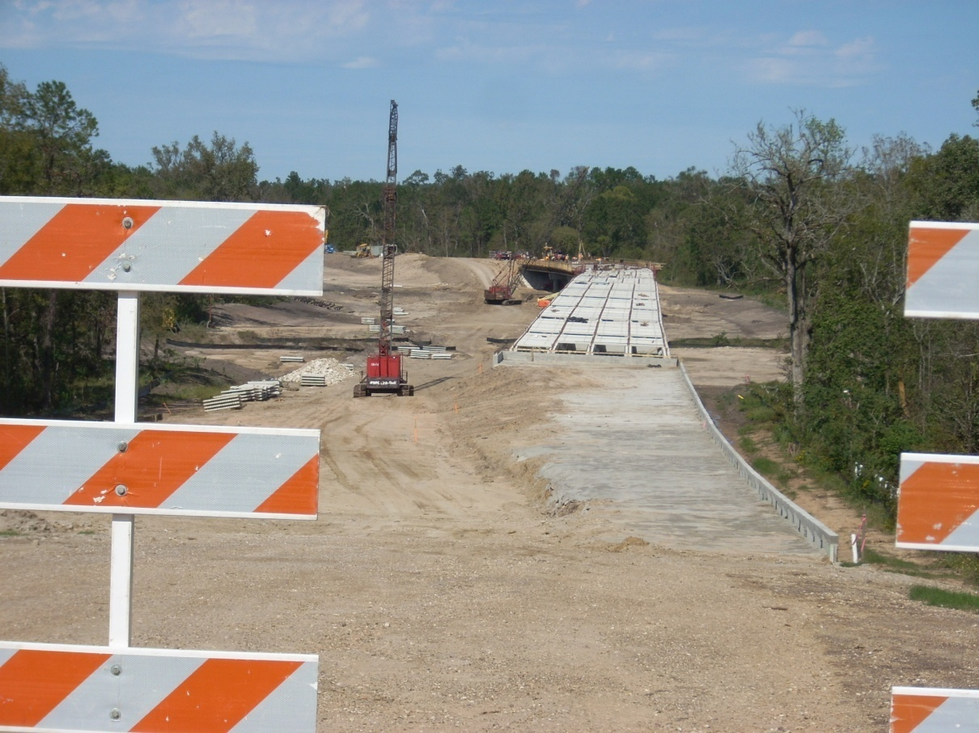
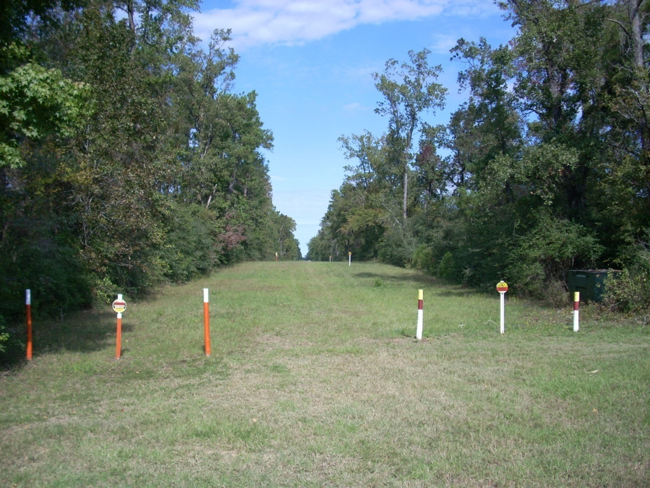
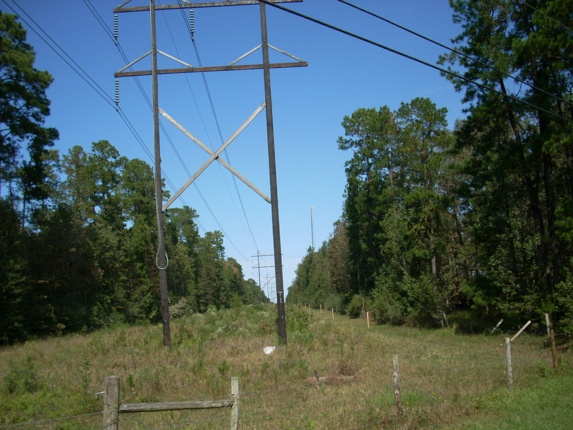
Corridor
Features
Fish Creek Parkway
Pipeline Corridor
Overhead Power Corridor
Pipeline / Power Corridor

Slide 36
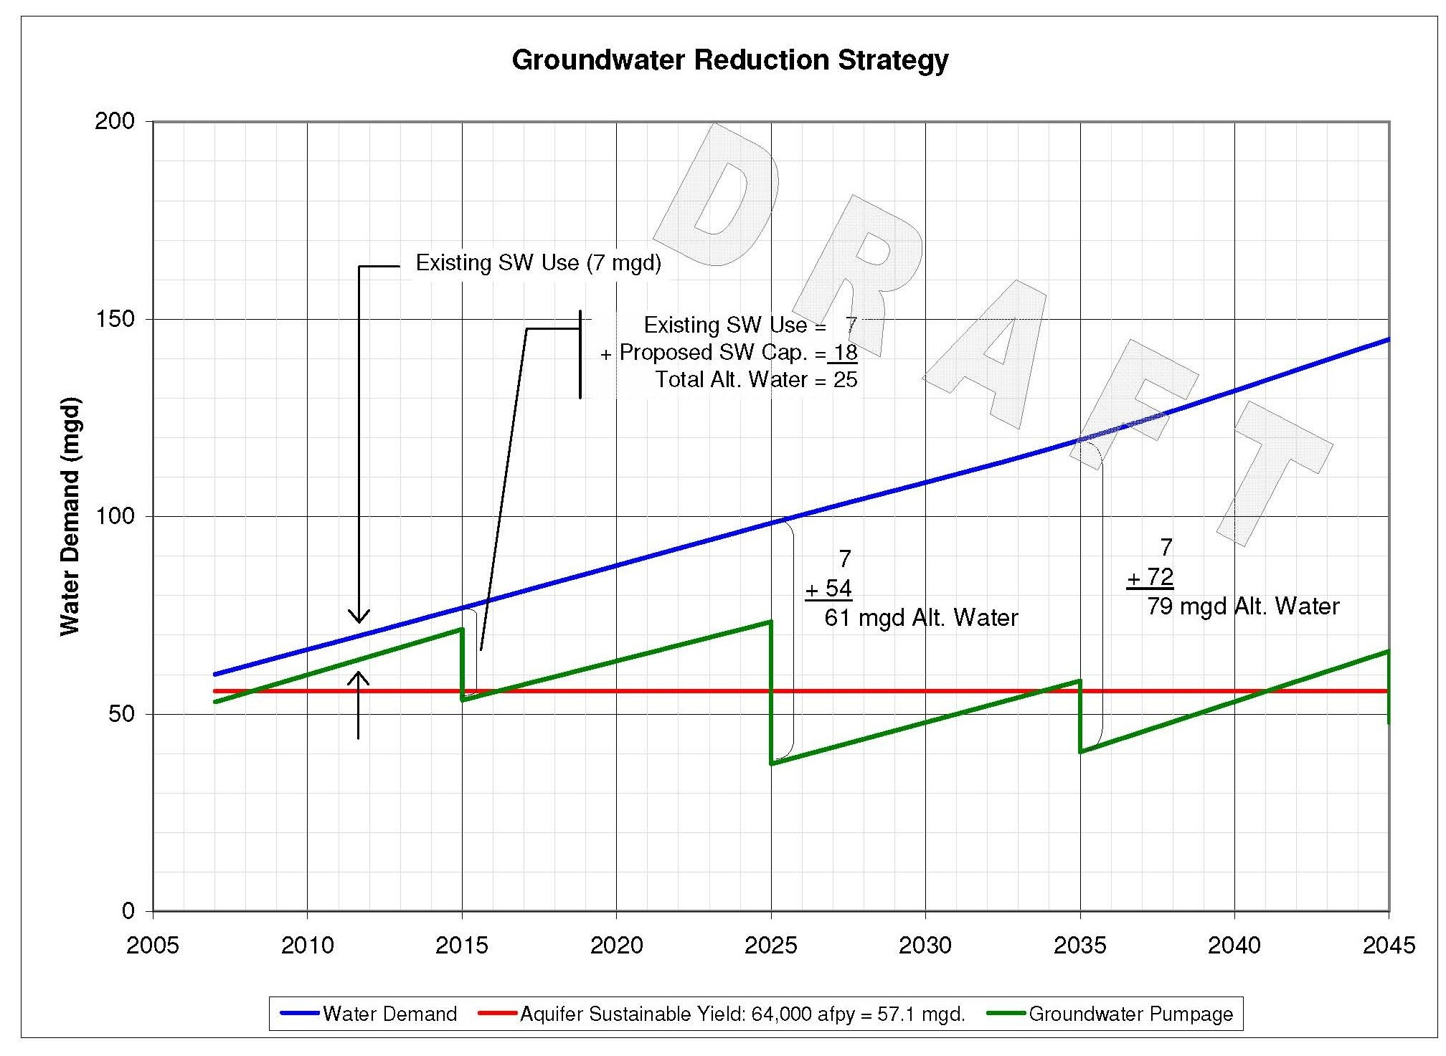

Slide 37
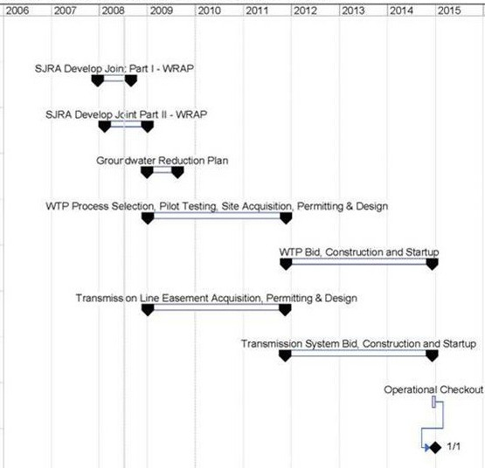
Montgomery County Alternative Water Supply Schedule

Slide 38

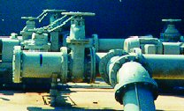
LSGCD WRAP II - Conclusions
New Water Supply Sources
Infrastructure Requirements
Schedule
Costs and Financing Methods
Preliminary Engineering for 2015
Conceptual for Future Phases

Slide 39


Assumptions for Reuse and Water Conservation
Strategy to reduce overall demand
Identify reuse projects
Conservation education assistance

Slide 40
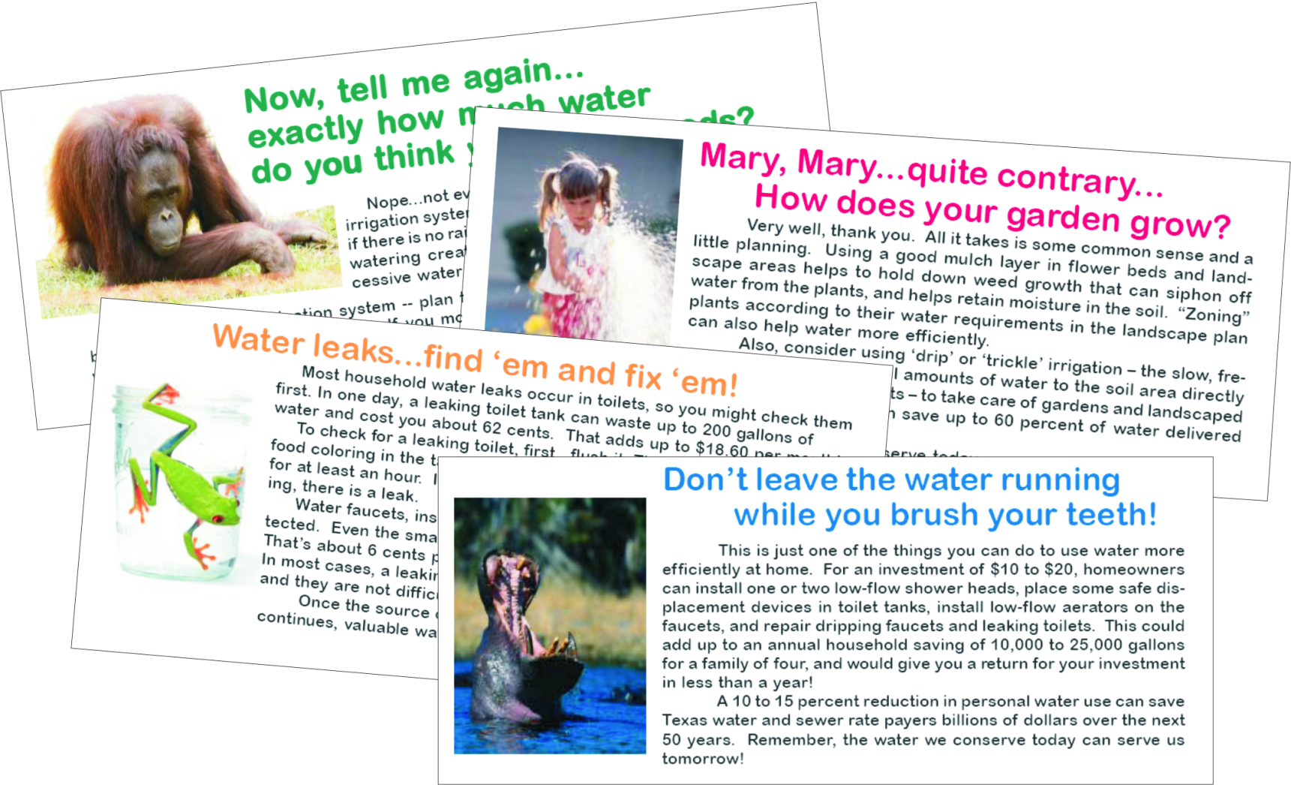
Assumptions for Reuse and Water Conservation
Conservation education assistance
  Billing Inserts

Slide 41




Assumptions for Reuse and Water Conservation
Conservation education assistance
  Billing Inserts
  Brochures

Slide 42


Assumptions for Reuse and Water Conservation
Conservation education assistance
  Billing Inserts
  Brochures
  Speakers’ Bureau

Slide 43
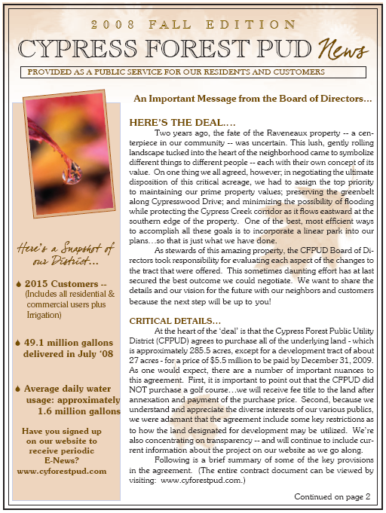
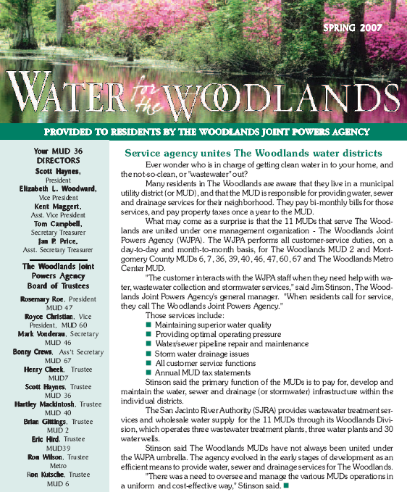
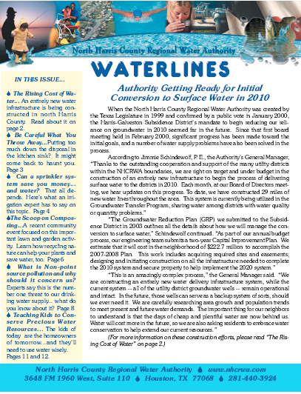

Assumptions for Reuse and Water Conservation
Conservation education
  Billing Inserts
  Brochures
  Speakers’ Bureau
  Newsletters

Slide 44
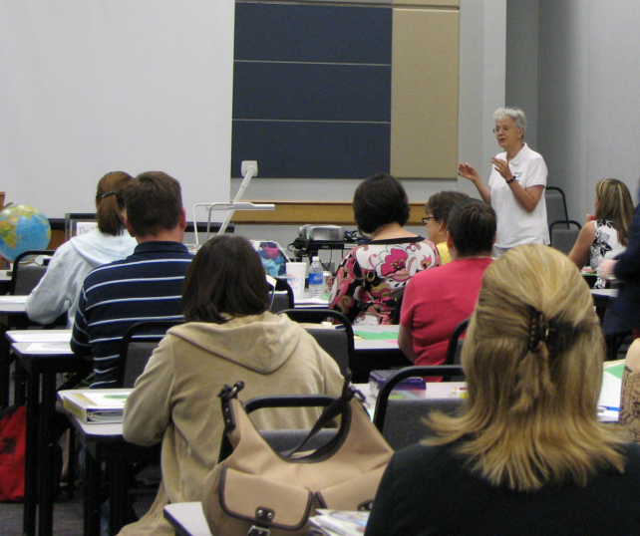
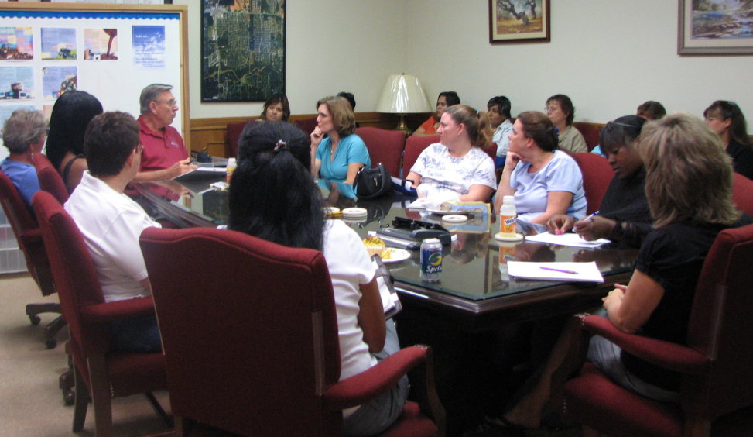
Assumptions for Reuse and Water Conservation
Conservation education assistance
  Billing Inserts
  Brochures
  Speakers’ Bureau
  Newsletters
  Workshops

Slide 45
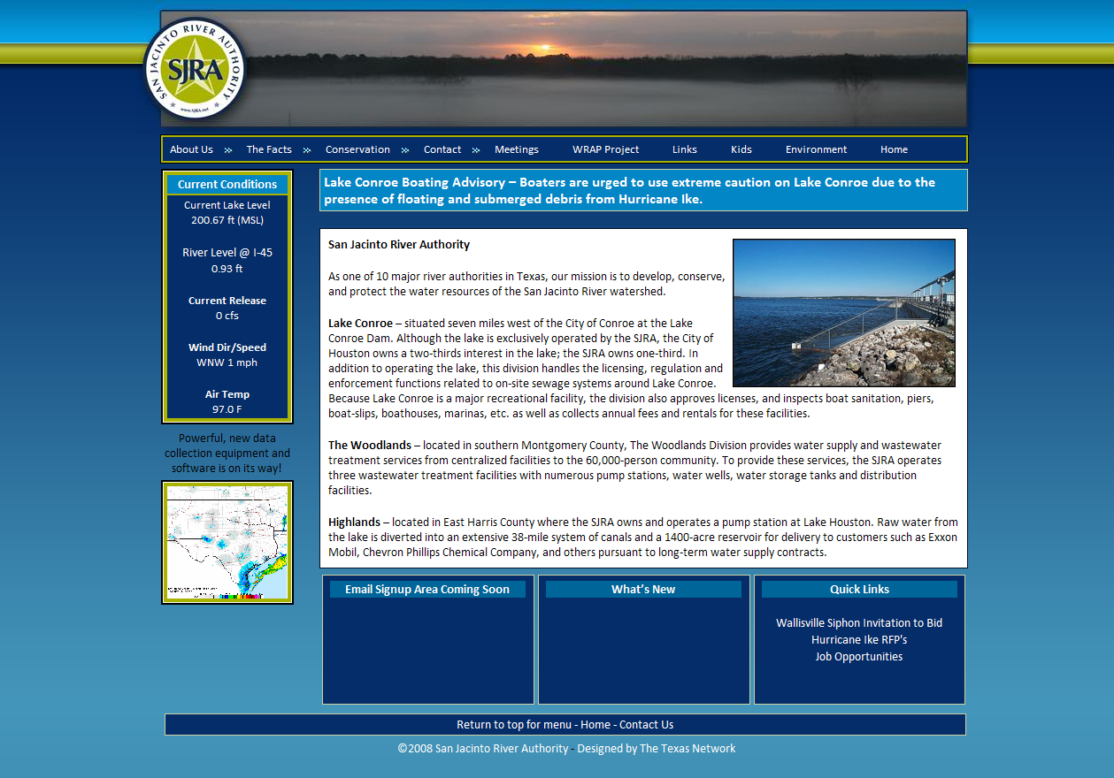
Assumptions for Reuse and Water Conservation
Conservation education assistance
  Billing Inserts
  Brochures
  Speakers’ Bureau
  Newsletters
  Workshops
  New Website

Slide 46

Additional
Meetings and
Workshops
to come…Please
sign up on our
website to receive
periodic notices!
www.sjra.net

